Slide 1
Projects Using The Top PHP Frameworks
Project 5: Photogallery(Laravel)

Slide 2
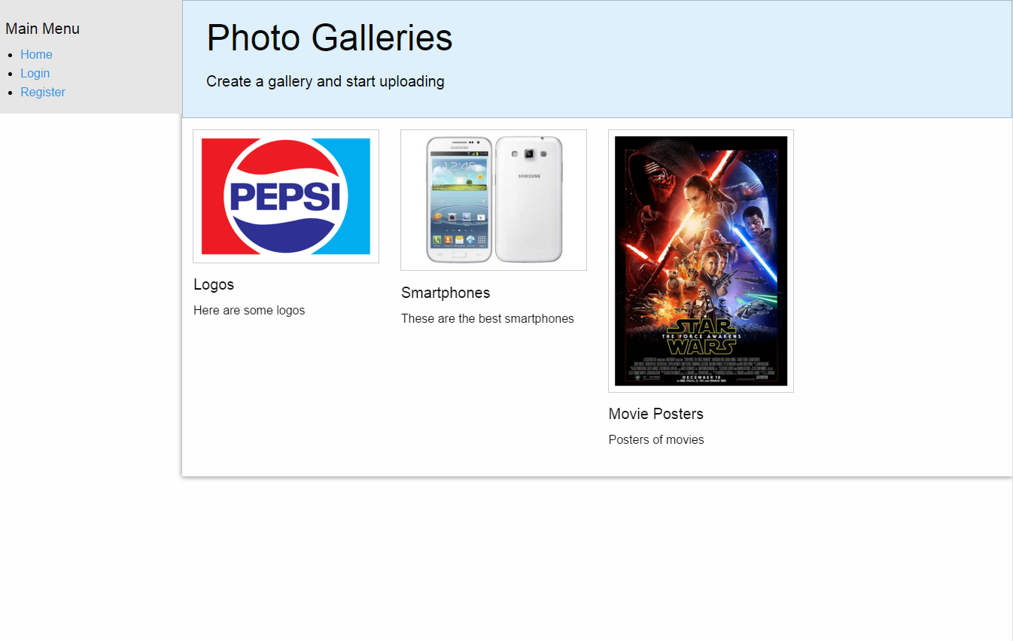
Application Description
A photo gallery where users can register and login to create galleries and upload photos

Slide 3
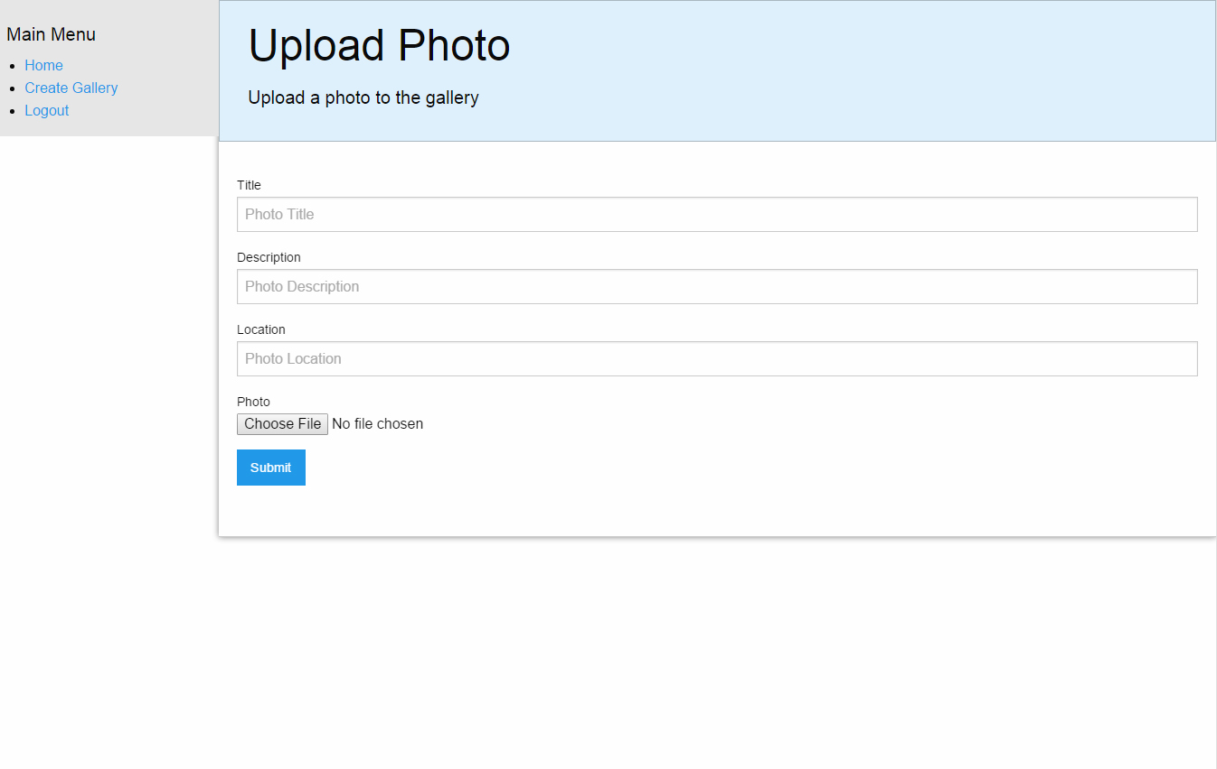
Features
User Login
User Registration
Access Control
File Uploads

Slide 4
Project Lectures
Section Intro
Controllers & Routes
Views & Layouts
Database & Create Gallery
Display galleries
Upload & Display Photos
Photo Details
User Authentication

Slide 5
What You Will Learn
How to install and build a Laravel 5 application
How to create a user login system
How to implement access control
How to create a Foundation css template
How to do file uploading

Slide 6


